Slide 1


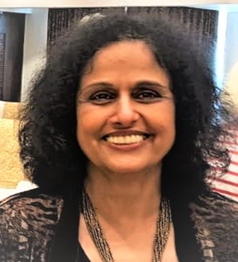


Thank you
Dr. Swati Bhave

